Slide 1
TNSDC - GENERATIVE AI FOR ENGINEERING
Venkatesh K
Final Project
3/21/2024 Annual Review

Slide 2
PROJECT TITLE
TNSDC - GENERATIVE AI FOR ENGINEERING
IMAGE COLORIZATION USING DEOLDIFY
3/21/2024 Annual Review

Slide 3


AGENDA
TNSDC - GENERATIVE AI FOR ENGINEERING
Problem Statement
Project Overview
End Users
Value Proposition
Solution
Modelling
Results
3/21/2024 Annual Review

Slide 4

PROBLEM STATEMENT
TNSDC - GENERATIVE AI FOR ENGINEERING
The task is to develop a user-friendly web application that utilizes the DeOldify model for image colorization. The application should allow users to upload black and white images and generate realistic colorized versions using deep learning techniques. The primary challenge lies in implementing an efficient and accurate colorization algorithm, optimizing the user interface for seamless interaction, and ensuring compatibility across various web browsers and devices. Overall, the goal is to create a robust and accessible solution that empowers users to effortlessly restore and enhance historical photographs and artworks through automated colorization technology.
3/21/2024 Annual Review

Slide 5

PROJECT OVERVIEW
TNSDC - GENERATIVE AI FOR ENGINEERING
The project scope includes designing and implementing a web-based image colorization application using the DeOldify model. It encompasses creating an intuitive user interface for uploading grayscale images and customizing colorization settings. The application will integrate backend infrastructure to process user inputs and communicate with the DeOldify model for efficient colorization. Additionally, the scope involves ensuring compatibility across different devices and browsers for seamless user experience The project aims to provide users with a robust platform for effortlessly transforming black and white images into vibrant, realistic compositions
3/21/2024 Annual Review

Slide 6
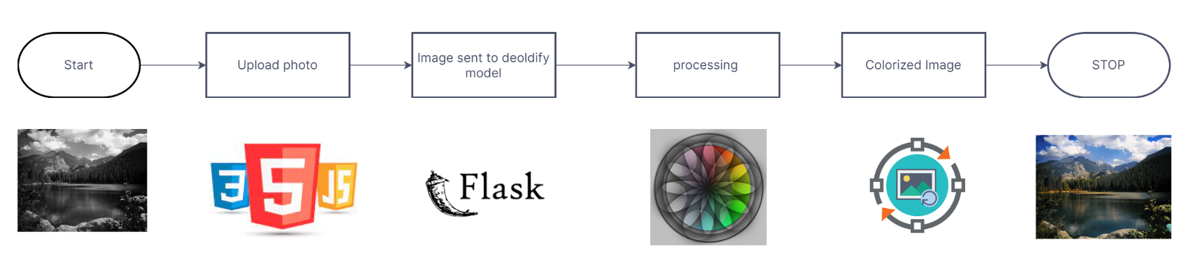
ARCHITECTURE
TNSDC - GENERATIVE AI FOR ENGINEERING
3/21/2024 Annual Review

Slide 7

WHO ARE THE END USERS?
TNSDC - GENERATIVE AI FOR ENGINEERING
History enthusiasts interested in historical photography and artwork restoration
Photographers and digital artists seeking to enhance their creative projects
General public users who enjoy exploring and sharing colorized historical images
Educators and students utilizing colorized images as teaching aids and visual references
Digital content creators incorporating colorized images into multimedia productions
Genealogists and family historians researching their family history and ancestry
Cultural and heritage organizations leveraging colorization technology for archival preservation and online exhibitions
3/21/2024 Annual Review

Slide 8

YOUR SOLUTION AND ITS VALUE PROPOSITION
TNSDC - GENERATIVE AI FOR ENGINEERING
SOLUTION OVERVIEW
Our solution is a user-friendly web application that utilizes state-of-the-art deep learning techniques, specifically the DeOldify model, for image colorization. Users can effortlessly upload black and white images through an intuitive interface and generate realistic colorized versions with just a few clicks. The application leverages advanced machine learning algorithms to accurately reproduce colors and enhance the visual appeal of historical photographs and artworks.
3/21/2024 Annual Review

Slide 9
YOUR SOLUTION AND ITS VALUE PROPOSITION
TNSDC - GENERATIVE AI FOR ENGINEERING
SOLUTION OVERVIEW
Efficiency: Streamlined colorization process for quick and easy results.
Accuracy: Precise and realistic colorizations thanks to advanced deep learning algorithms.
Accessibility: User-friendly interface makes colorization technology accessible to all.
Versatility: Suitable for diverse use cases, from historical restoration to multimedia applications.
Engagement: Revives historical images, fostering curiosity and appreciation for cultural heritage.
Innovation: Continuous research and development to push the boundaries of image colorization technology.
3/21/2024 Annual Review

Slide 10

THE WOW IN YOUR SOLUTION
TNSDC - GENERATIVE AI FOR ENGINEERING
Realistic colorization through advanced deep learning techniques.
Intuitive and user-friendly interface for effortless image upload and colorization.
Instant transformation with real-time results, offering immediate gratification.
Historical restoration, bringing old photos to life in vibrant color.
Customization options for personalized and creative interpretations.
Continuous improvement through ongoing research and development efforts.
3/21/2024 Annual Review

Slide 11
MODELLING
TNSDC - GENERATIVE AI FOR ENGINEERING
DeOldify Model: Utilizing the DeOldify model, a cutting-edge deep learning architecture tailored for image colorization tasks.
Pre-Trained Weights: Leveraging pre-trained weights and parameters to ensure high-quality colorization results based on learned representations.
Fine-Tuning: Optimizing model performance through fine-tuning techniques to adapt to specific domains or applications.
Data Augmentation: Increasing dataset diversity and robustness with augmentation methods like cropping, rotation, and color jittering.
Evaluation Metrics: Assessing model performance with metrics such as colorization accuracy, perceptual quality, and computational efficiency.
Deployment: Integrating the trained model into the web application infrastructure for efficient and scalable colorization processing.
3/21/2024 Annual Review

Slide 12
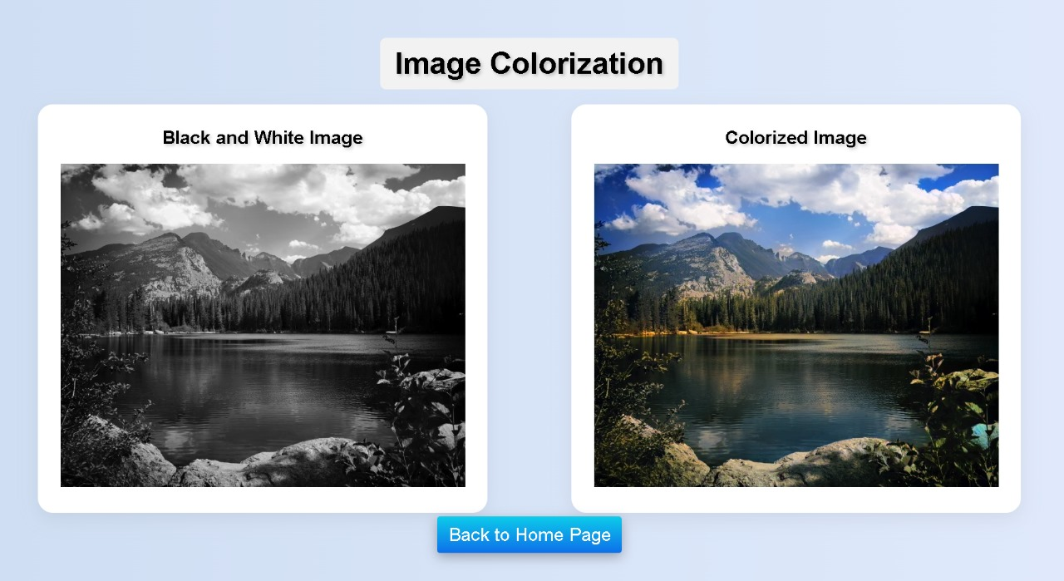
RESULTS
TNSDC - GENERATIVE AI FOR ENGINEERING
https://github.com/venkatesh1220/imageColorization
3/21/2024 Annual Review

